Slide 1


Hands-on Workshop: pharmaverse sponsored by Genentech
Michael Rimler, GSK,
Ross Farrugia, Roche/Genentech
Mike Stackhouse, Atorus Research &
Sumesh Kalappurakal, J&J/Janssen
Notes:
“Can we collaborate to lessen the burden of e2e clinical reporting?”
Optional pre-read: Introduction to R for the Statistical Programmer: https://atorus-research.github.io/phuse_intro_to_r_2021_website/ (see Content & Resources sections)

Slide 2

Ice-Breaker
Firstly, it is a pleasure to be F2F and interact with colleagues across the industry in person once more
Just to get us all warmed up in the room, please turn to the people sat around you and discuss the following question….
Although the COVID-19 pandemic has touched and shaped each of our lives in ways we will never forget, for you were there any personal unexpected “silver linings” you’ll take from the past 2-3 years?

Slide 3
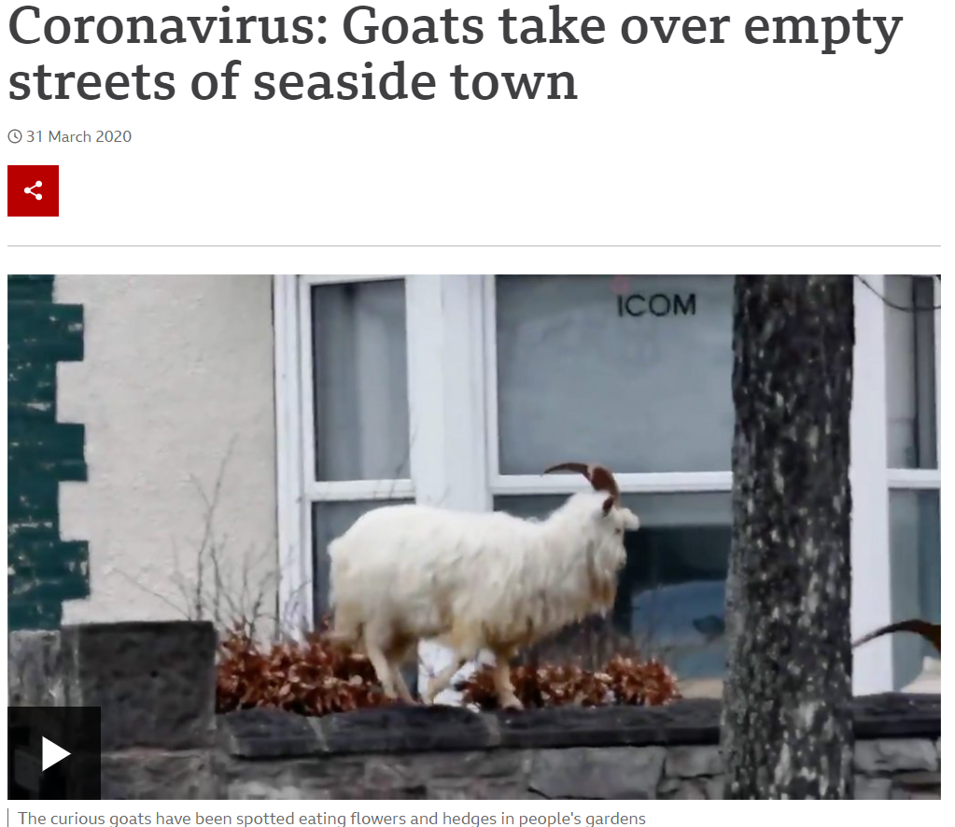
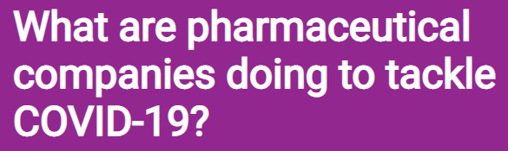

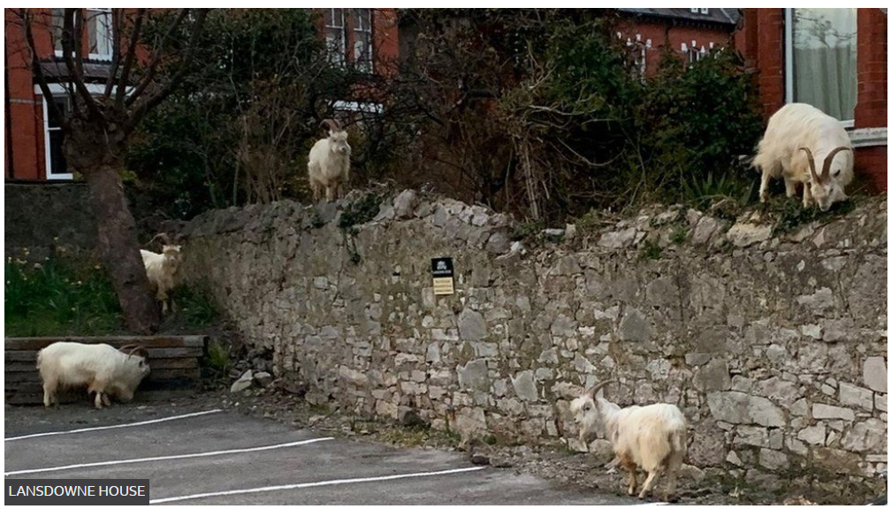
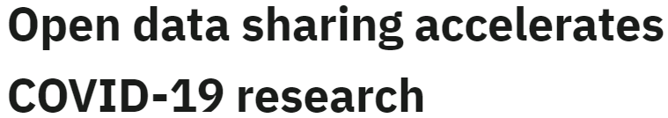

Slide 4
Agenda
Framing the industry challenge of e2e clinical reporting
Introducing pharmaverse
Hands-on trial – try before you buy “use for free via open source!”
R-Shiny interactive displays demo
Governance & contributions
Panel – open Q&A with select council reps/package leads/developers
Closing – what next…

Slide 5
Framing the challenge

Slide 6

Framing the challenge – WE NEED YOU!
We’d like to start by asking you all some questions about your current state clinical reporting solutions and your perspectives around these
To do this you’ll need to connect to Menti.com from your computer or smart device and enter the code we show next
Please answer honestly, as there are no right or wrong answers and everything is anonymous
Notes:
Menti link: https://www.mentimeter.com/s/ae35bd7884905054e1e336afd3b30342/ebaaf5ea6eab/edit

Slide 7
Our Story
All the founding members had shared ambitions for industry-collaborations that could lead to open source solutions for all
GSK & Atorus first started collaborating to address clear gaps of pharma-specific utilities such as {xportr}, {timber} & {metacore}
Roche/Genentech got involved with GSK to co-develop {admiral} as well as opening our {nest} packages to certain external collaborators
J&J/Janssen became involved through both of the above
We all recognised how much effort each company is spending building and maintaining our own silo’ed solutions to e2e clinical reporting, and the challenges this brings to HAs
“pharmaverse” was born…
Notes:
Link our story back to challenges from the audience Menti findings to show where our experiences align.

Slide 8
Introducing pharmaverse

Slide 9
What is pharmaverse?
A curated, opinionated, pharma stack of open source R packages to enable clinical reporting (from CRF to eSubmission) backed by a community of passionate individuals and organisations committed to co-creating efficiency in our mission to improve health.
Tabulation
Analysis Results
CRFs
Lab Assays
PK
Medical Coding
ADaM
“One PROC Away”
Derived Data
Traceability
eCTD Portal
SDTM
Traceability
No derivations
Comprehensive
Data Displays
CSR
Data Submission Package
Quality Control
Collection
Analysis Ready
Submission

Slide 10



Why is pharmaverse?
Solve problems together
Share
solutions
All boats rise
Notes:
From our charter: The benefits would be as follows:
- Industry collaboration leading to more robust and well-thought-out solutions with shared development and maintenance efforts, thus distributing the cost and burden across multiple organizations
- Greater potential to bring unified solutions to regulators demonstrating collaboration between industry and standards organization to form workable solutions
- Better enablement of our medicines to reach patients and society faster through the pooling of skills and talents and accelerating how the industry generates insights from patients’ data - and to do this in a more sustainable way
- Attraction of the next generation of great software developers and data scientists to Pharma and providing increased transparency of our industry

Slide 11
What is not pharmaverse?
Open source R packages in which the governing council decides:
The design / functionality of the package
How the package is to be developed
Who will develop and own the package
How the package will be tested
Who will contribute to the package
Where the package will be hosted
Notes:
We can give recommendations for new packages from our learnings on things like admiral, but our council is not going to take over all the decisions for your package, i.e. you still have freedom as developers.
Plus many of the packages already existed pre-pharmaverse so not like we’re in any position to mandate things
we are not the developers of packages.
We do not determine the strategy of which packages exist or when features are added – but we can make suggestions given our 50,000 foot view.
If they see a gap – they can fill it or add an issue to the GH repo of an existing packag

Slide 12





Who is pharmaverse?
Governing Council
And you…
Notes:
Stress that although there are many packages already out there, we also have many gaps and we’d like to fill by starting new across-company co-development collaborations. Mike S will talk about this more later and how we can help get these started, as well as how any individual can get involved and make contributions towards the cause. It is important that pharmaverse brings together a “community” of like-minded industry professionals with shared challenges, where people support each other (just like the wider R community does beyond pharma).

Slide 13
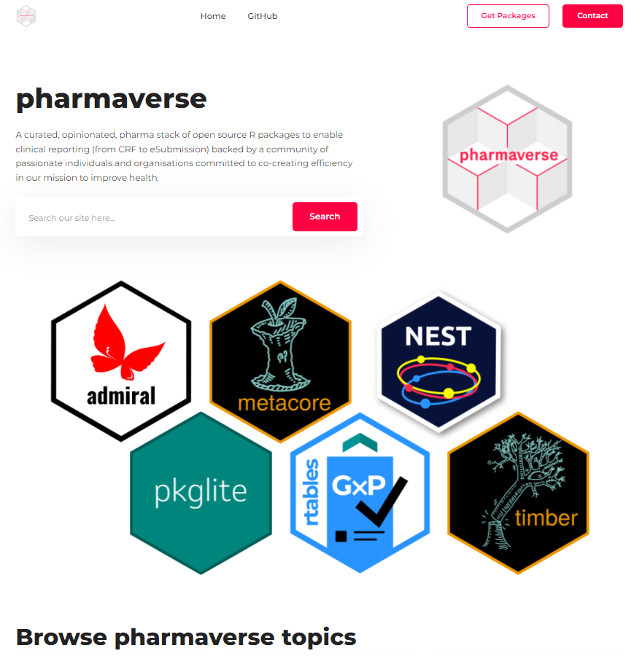
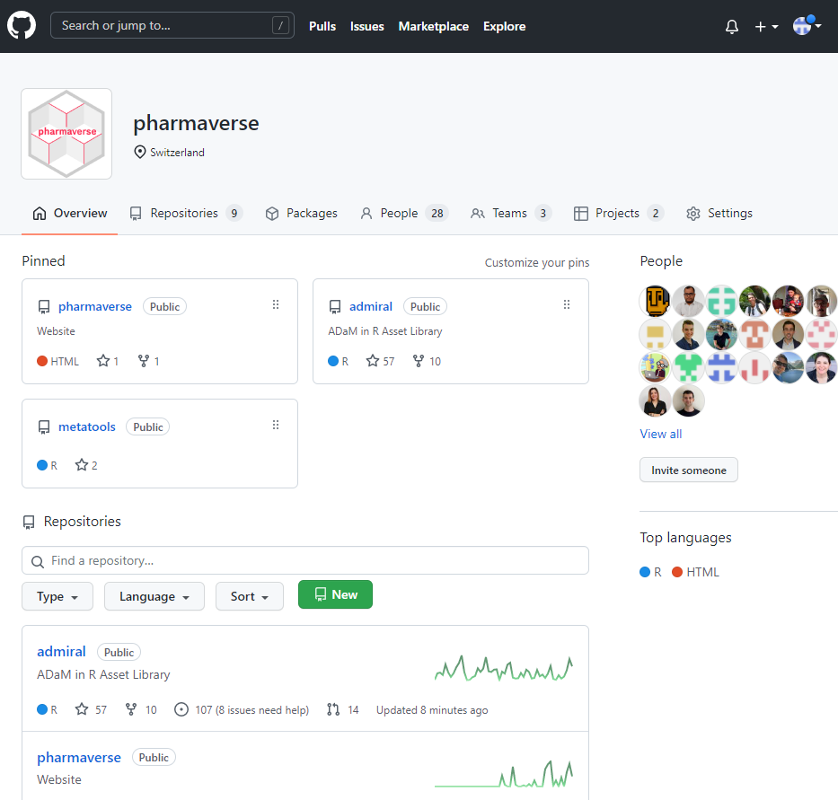



Where is pharmaverse?
Communities
https://pharmaverse.slack.com
pharmaverse
https://pharmaverse.org/
https://github.com/pharmaverse/

Slide 14



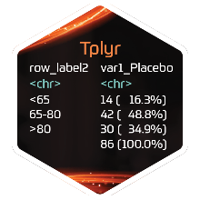













What is pharmaverse?
Collection
Tabulation
Analysis Ready
Analysis Results
Submission
diffdf
tools
validation

Slide 15
Hands-on trial

Slide 16

Hands-on Trial
To demonstrate how (hopefully) simple pharmaverse packages are to pick up and use we will run a 30 mins hands-on session where you can all try out some
We have 3 Exercise Sheets for you to choose from:
Beginner: for those with limited or no prior R or ADaM/TLGs experience
Advanced: for those with 1+ years of R and ADaM/TLGs experience
If you find any issues consult the package documentation, and if still stuck then ask for help from one of our facilitators or consult the provided Solution Sheets
Notes:
Exercises depend on your R and ADaM/TLGs experience levels – if unsure we recommend start with one of the harder levels and then work your way up to the easier as needed, as they’re all similar underlying exercises.
Mention 30 mins break follows and people are free to stay in the room and continue the exercises if you’d like longer to practice.

Slide 17
Hands-on Trial
We will be using RStudio Cloud
Benefit being we can all use R with the same config, rather than setting up R on each OS
We recommend the Firefox or Chrome browsers
You can find the project associated with the workshop as emailed:
Once logged in, you should see the pharmaverse-phuse-workshop project
(If not, raise your hand and a facilitator can help you)
Clicking on the project will open an RStudio Session with dummy data available and all required packages pre-installed - you can use this to try out the hands-on exercise of your choosing

Slide 18
Hands-on Trial – Step-by-Step
Click the link in the email “Michael Stackhouse has invited you to access a space on RStudio Cloud” and sign up
Open the pharmaverse-phuse-workshop project
In the bottom-right window, navigate to admiral_exercises and then the level of your choice
Download the Exercise Sheet which talks you through what you need to do
Open the R program (e.g. beginner_exercise.R)
Work through the exercises and then compare against the Solution sheet
Repeat for rtables and Tplyr
Notes:
RStudio Cloud link would have been provided to registered attendees by email prior to the workshop – NEED TO CLICK “I ACCEPT”. If you didn’t receive this then raise a hand and we can help you.

Slide 19
R-Shiny demo

Slide 20
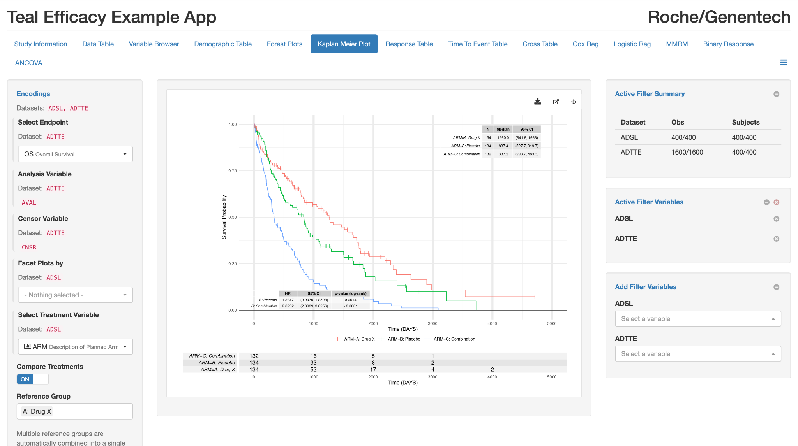
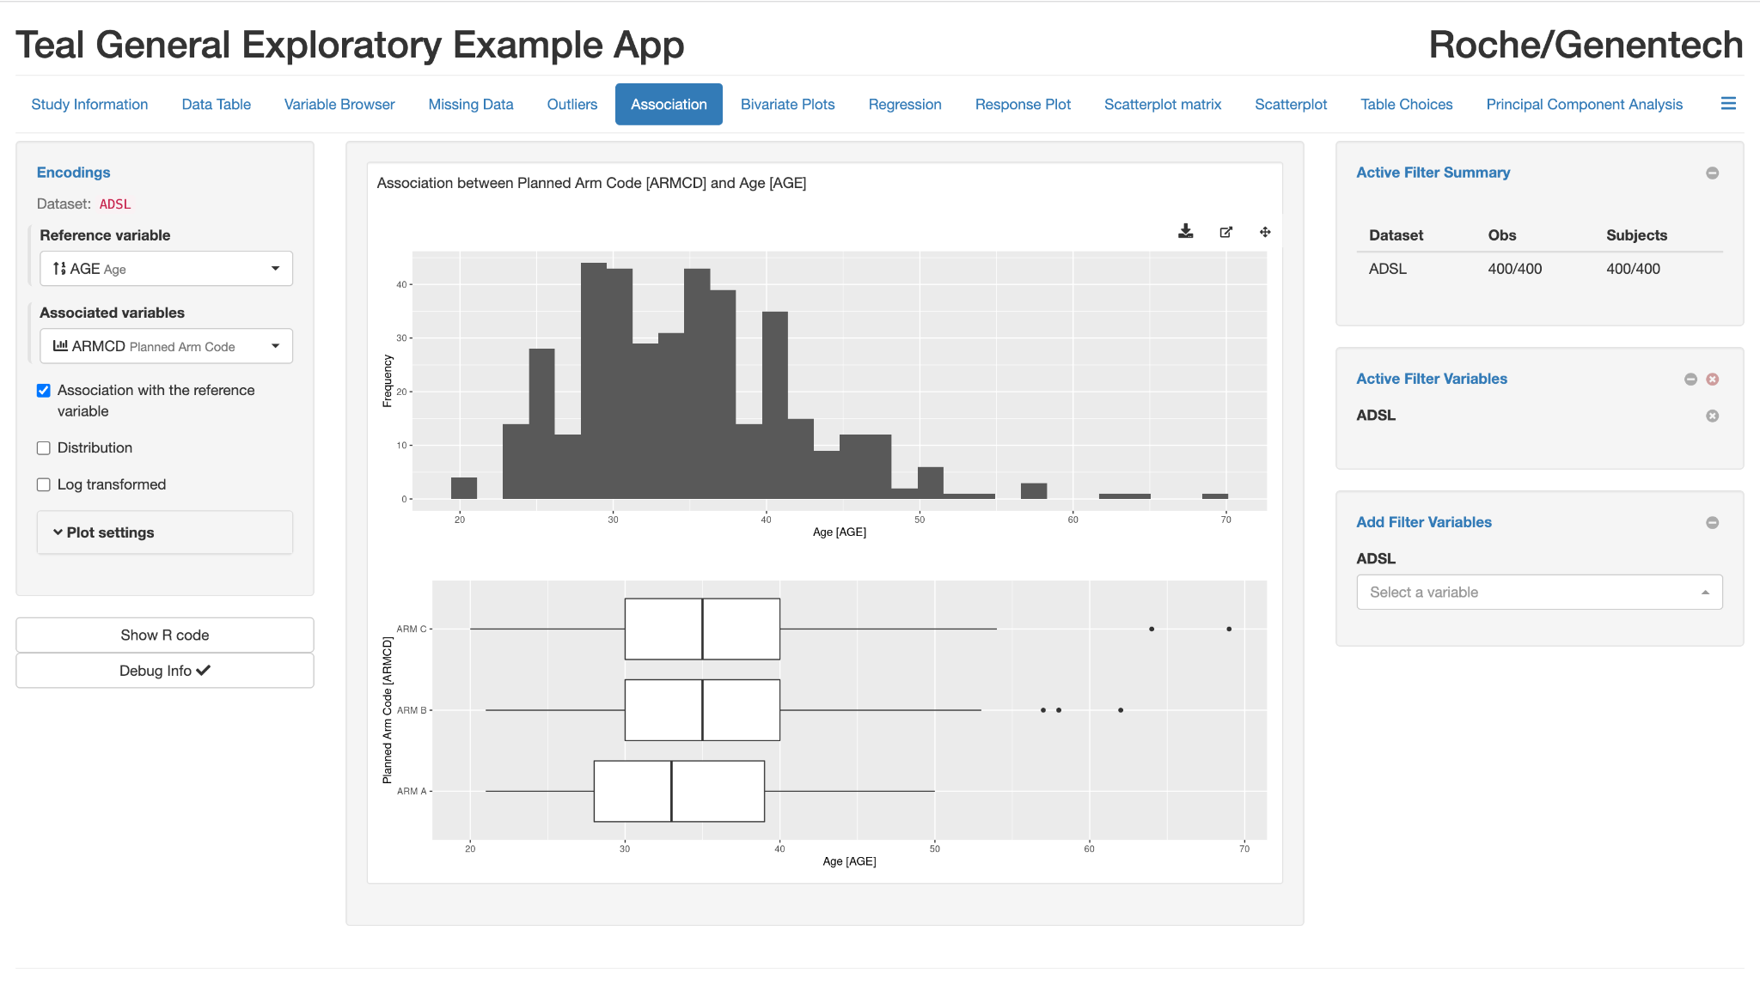
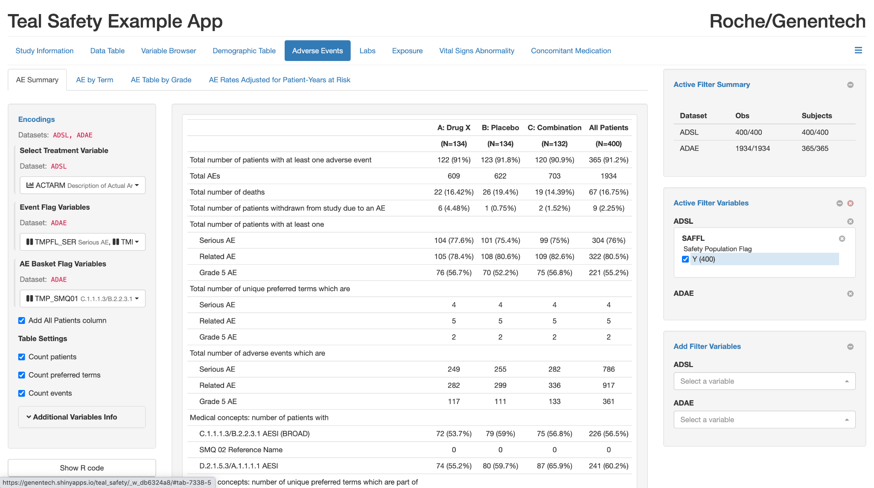
Shiny Examples
https://genentech.shinyapps.io/teal_efficacy/
https://genentech.shinyapps.io/teal_exploratory/
https://genentech.shinyapps.io/teal_sadfety/

Slide 21
Shiny Demo
DEMO

Slide 22
Governance & contributions

Slide 23
Who can contribute?
Anyone!
Individuals
Organizations
Collaborations
Collaboration is encouraged
Pharmaverse is a platform to encourage it

Slide 24
Contributor Roles
Commitment Level | Description
Council representative | Strategy and decision-making body across pharmaverse, e.g. to highlight gaps, initiate collaborations, and to select pharmaverse preferred packages
Package co-lead | Strategy lead and maintainer for a specific pharmaverse package or codebase
Individual contributor | Development contributor to any pharmaverse package or codebase
Working Group Member | Participant in Pharmaverse Working groups

Slide 25
Council Representatives
Expected organizational commitment to pharmaverse
Commitment of contribution to at least 2 open-source packages under pharmaverse
Representatives will
Help set strategy
Guide pharmaverse package inclusion criteria
Initiate projects/workshops
Support collaboration guidance

Slide 26
Package Co-lead
Decides on strategy for a specific package
Scope, contribution model, testing, governance, etc.
Neutral development area available
Packages can now be developed, live, or migrated under pharmaverse

Slide 27
Individual Contributor
Advocate for and use pharmaverse packages
Provide pharmaverse package feedback
Develop new functionality and pull request
Volunteer for package testing cycles

Slide 28
Panel

Slide 29
Closing

Slide 30
What next for pharmaverse…
Some further plans and ideas we have:
Curating the pharmaverse package list into an “opinionated” stack
Building community and open support model via Slack
Enabling new collaborations to target identified common gaps in the clinical reporting flow
Helping connect individuals with suitable open source packages to contribute to, e.g. Free agent board / Help wanted Git scrapes

Slide 31
A new era of collaboration
Imagine a world where…
Every company (large & small), charity, academic group etc all have access to FREE solutions to support creating a clinical submission
Regulators receive more consistent packages delivered using trusted code, thus speeding up approval times and patient access
Less resource intensive clinical reporting leads to individual data science talents being freed to help generate new scientific insights
Our regulatory pathways are revolutionised in a language-agnostic way opening the doors for less paper-based submissions via interactive tools
We ACHIEVE all of the above TOGETHER!

Slide 32
Thank you for your engagement today! Slack channel: https://pharmaverse.slack.com/ (use this link to join our community, if you don’t already have access) Site: https://pharmaverse.org/

